Slide 1
OSDU Data Concepts
Reminder & Generalities
London F2F – April 2023

Slide 2
Data Concepts Working Group

Slide 3
“Data Concepts” Working Group
Born at the early days of OSDU – oct. 2018 as
Data Definition & Modeling Sub-Committee (DDSC)
Mandate to define main data specifications for the Data Catalog (“Core Services”).
Datatype footprint definition
Datatype name, description, group-type.
Attribute based schemas (name, type, description,…)
Agreed file format - if any
Set the contextual Reference data (type, governance, values,…)
Progressively moving to “Data Concepts” – engaging with PMC to assist “Projects”
Ensuring the coherency of the catalog - “Body of Knowledge” – joining the dots.
Bringing people (SMEs and Architect) to support Projects – and DDMS “Content” models.
Defining schemas is just the beginning of the story – datatypes must be ingested, discovered, published… This is the role of the PMC & DC twins !

Slide 4
Working Group Structure
Core Concepts
PPDM Integration & Reference Data
Transverse DD Teams
Delivering « Universal » Contents
Test Data
Documents
Geochemistry
Petrophysics
CCS
Production
DD Staff working within Projects
Reservoir Modeling
Self Standing « Domain Based » DD Teams
« Domain Based » DD Teams Embedded within Project Teams
Reservoir Management
Renewables
Well Delivery
Seismic

Slide 5
Working Group Structure
Core Concepts
PPDM Integration & Reference Data
Test Data
Documents
Geochemistry
Petrophysics
CCS
Production
Reservoir Modeling
Reservoir Management
Renewables
Well Delivery
Seismic

Slide 6
Working Group Structure
Core Concepts
* : Thomas Gehrmann
PPDM Integration & Reference Data
* : Linda Bragg
* : Keith Wall (dep.)
Test Data
* : Vacant
Documents
Geochemistry
Petrophysics
CCS
Production
* : James Pipe
* : Charles Onojeghuo
Reservoir Modeling
* : Alice Chanvin
* : Chris Hough
(dep)
* : Jenni LaRue
Reservoir Management
Renewables
Well Delivery
Seismic
* : Pierrick GAUDIN
* : Leti Rodriguez
* : Vacant
* : Kim Brosnan
* : Keith Wall

Slide 7
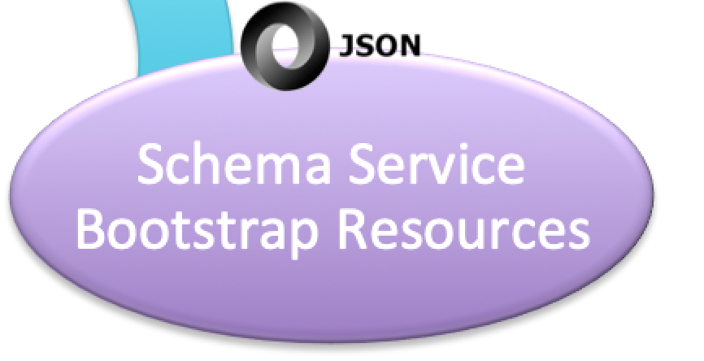
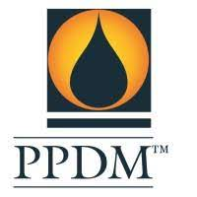




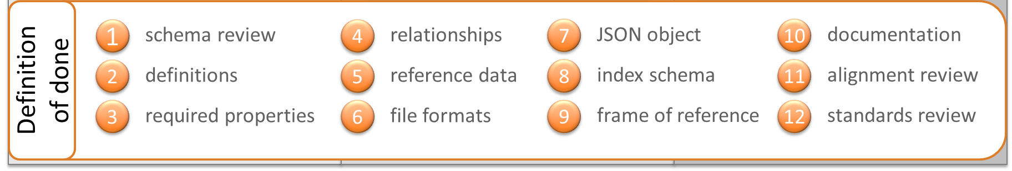
OSDU’s Datatype Delivery Pipeline - DDSC Focus
EA Ideation
(OMC-Focal Point Approval)
Detailed Def. of Use Cases
Datatypes List
Schema Definition
(Community Review)
Schema Generation
Script Automated
Technical Validation
Test Data, Experts
Merge to Master
PMC Handovered
Snapshot to Community Gitlab
Review Feedbacks
Donations
Definition of Done (Test Data Examples,…)

Slide 8
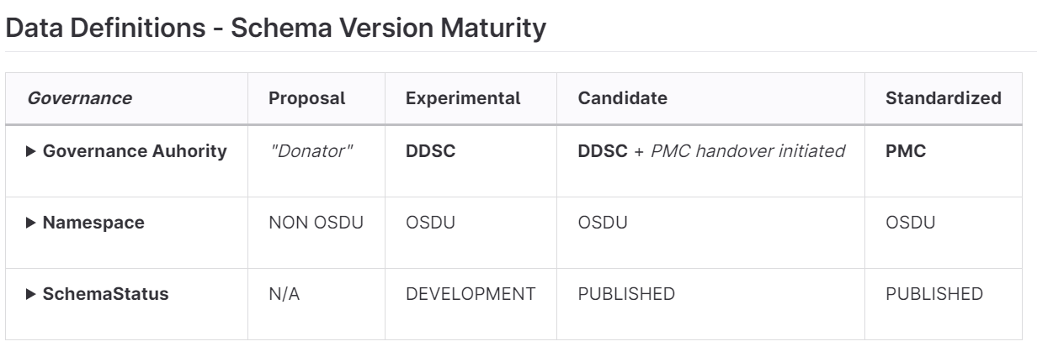
OSDU’s Datatype Delivery Pipeline – « Donation »
EA Ideation
(OMC-Focal Point Approval)
Detailed Def. of Use Cases
Datatypes List
Donations
« OSDU-ing »
Template
Naming Conv.
« Integrate & Reuse »

Slide 9
OSDU Platform Catalog & Content

Slide 10
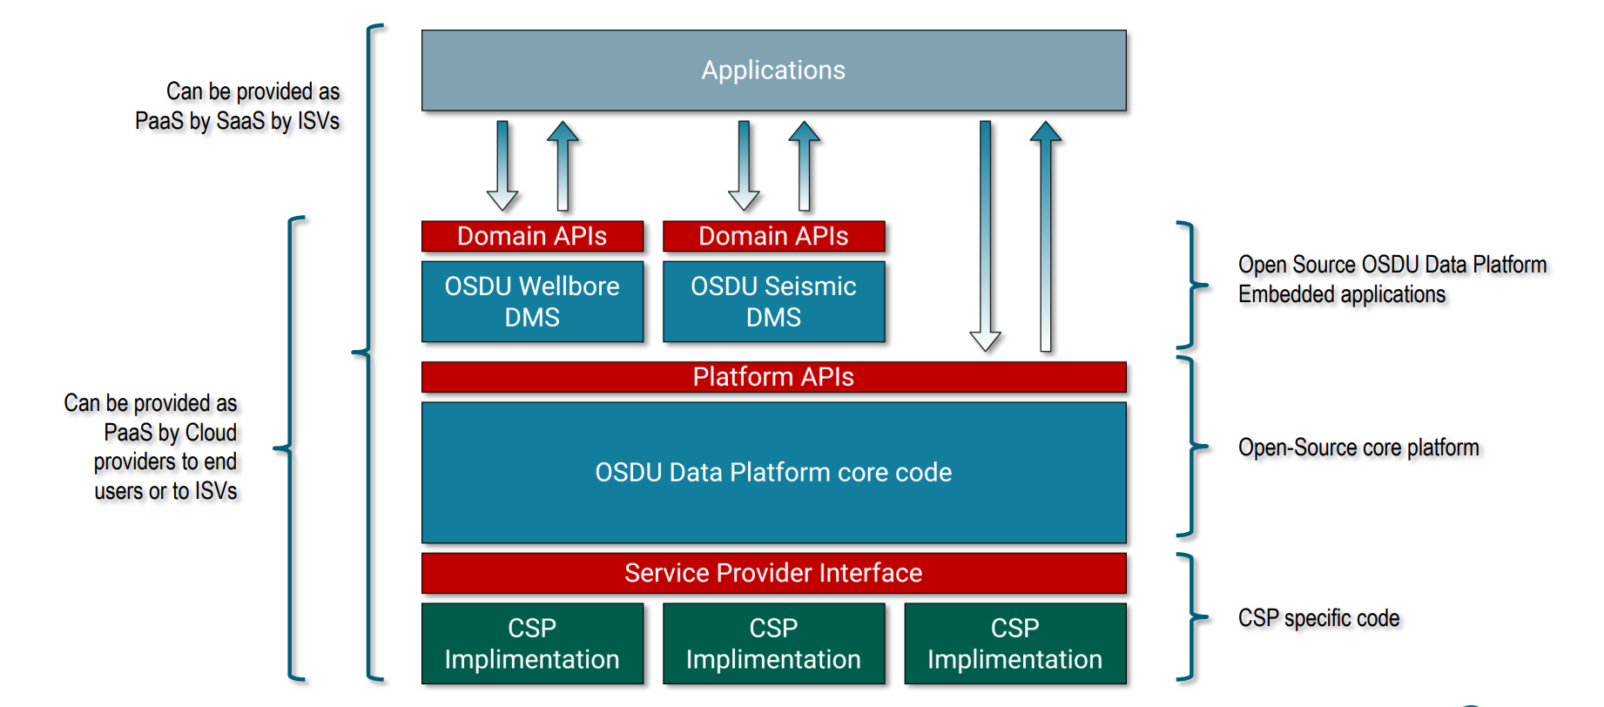
OSDU Architecture
Notes:
Generic APIs are the foundation that our OSDU data platform is built on. They are published as open endpoints to access metadata and data as generic types allow the continuous addition of new data types support an ecosystem of:
System developers extending the platform
Systems integrators integrating the platform
Customers adopting the platform
Domain APIs provide an (E&P) domain specific way of accessing the system. They carry semantics not possible in a generic API, making them a powerful tool for application developers who want the very best performance for accessing data. We may need to update this type-safe optimized API every few years, but they allow storage optimization based on access patterns over generic APIs.
A Domain Data Mgmt Service (or DDMS service) is one that persists data of a specific domain and provide access through optimized domain APIs. It is governed by overall platform but is developed and evolved independently.

Slide 11
Core Services Overview – Native “S.o.R” OSDU
Security & Compliance
Legal
Entitlements
Policy
Reference
CRS Catalog
CRS Conversion
Unit
System
Indexer
Storage
Search
File
Dataset
Schema
Partition
Register
Notification
Notes:
Before jumping into DDMS – lets talk abit about core services

Slide 12
Core Services Overview – Native “S.o.R” OSDU
Security & Compliance
Legal
Entitlements
Policy
Reference
CRS Catalog
CRS Conversion
Unit
System
Indexer
Storage
Search
File
Dataset
Schema
Partition
Register
Notification
Data
Discovery & Governance
Notes:
Before jumping into DDMS – lets talk abit about core services

Slide 13
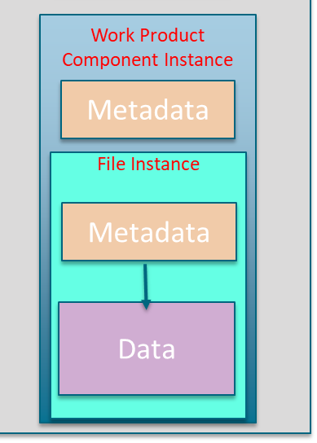
OSDU Entities – in “SoR”
Work-Product-Component :
Built from a datafile, stored as its native format.
Indexed, Searchable and published through a set of buisiness metadata.
The key ‘group-type’ for business data
Eg. « WellLogs »
Dataset:
Metadata of digital files, .e.g File size, checksum etc.

Slide 14
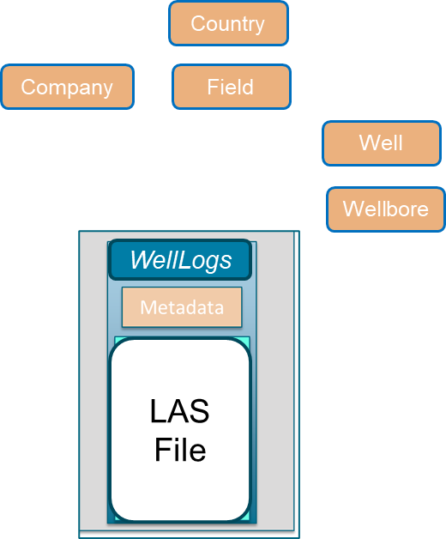
OSDU Entities – in “SoR”
Work-Product-Component :
Built from a datafile, stored as its native format.
Indexed, Searchable and published through a set of buisiness metadata.
The key ‘group-type’ for business data
Eg. « WellLogs »
Dataset:
Metadata of digital files, .e.g File size, checksum etc.

Slide 15
OSDU Entities – in “SoR”
Work-Product-Component :
Built from a datafile, stored as its native format.
Indexed, Searchable and published through a set of buisiness metadata.
The key ‘group-type’ for business data
Eg. « WellLogs »
Dataset:
Metadata of digital files, .e.g File size, checksum etc.
This was the « finality » of OSDU – to store, index, publish the content of the files as a WPC

Slide 16
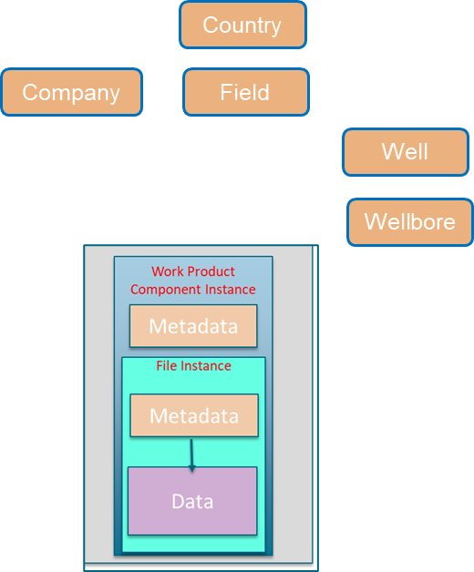
Core Services vs. DDMS

Slide 17
OSDU Platform Content – Files / DataSet

Slide 18
Basics “Content” Container - within “SoR”
Files
Existing Standard File Format (LAS,WITSML,…)
Generic *.csv files delivered by OSDU
Optimized content files (JsonWellLog Format)
« In-House » internal file formats.
Other Dataset:
External Data Source Service
ETPServer

Slide 19
Basics “Content” Container - within “SoR”
In Core Services:
OSDU supports only ingestion, discovery & publishing of the File itself
Needs a dedicated parser to access to the content.

Slide 20
OSDU Platform Optimized Content Management Standardized DDMS

Slide 21
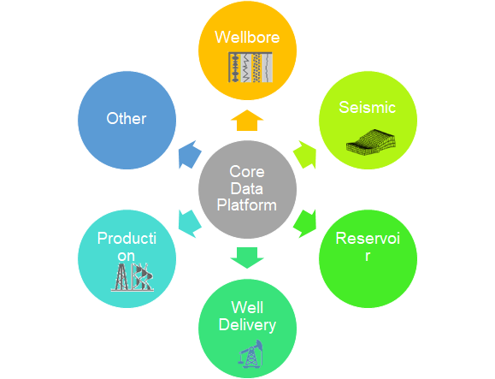
Framework
Extension can be registered, discovered and invoked programmatically
Ability to develop domain extensions in parallel
Support domain developers thru type-safe interfaces instead of generic core services
Address domain specific concerns
Notes:
OSDU therefore encourages such optimized domain-centric micro-services to address this need - such services are called Domain Data Management Services or DDMS. The OSDU platform therefore becomes a framework where such extensions can be registered, discovered and invoked programmatically. This allows for both open-source and proprietary extensions to be added to the platform:
Ability to develop domain extensions in parallel
Split domain data flows, domain storage/access concerns
Support domain developers thru type-safe interfaces instead of generic core services
Address domain specific concerns
Core Platform governs minimum principles across domains and shared services

Slide 22
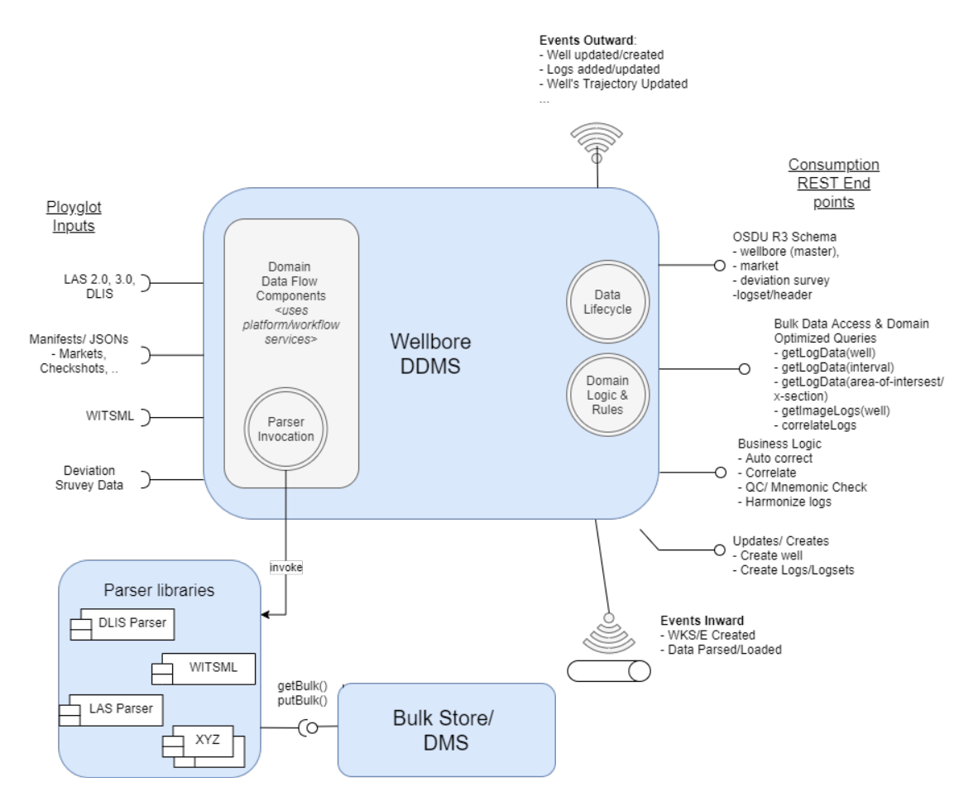
DDMS Capabilities
Notes:
A DDMS is a set of:
Highly optimized storage & access for bulk data, with highly opinionated API’s delivering the data required to enable domain workflows
Strongly governed schemas that incorporates domain-specific perspective and type-safe accessors for registered entity types
A Domain Data Management Service (DDMS) can be seen as any source of truth for data that manages the data life cycle, satisfies given mandatory data access concerns, and makes its data globally discoverable and retrievable through the OSDU Data Platform. Domain Data Management Services provide type-safe entity access and optimized accessors for bulk data to access 1D, nD data in point, plane, volume and other consumption centric access pattern.
A DDMS can implement a "shadow record" pattern where for each piece of data stored into the DDMS a corresponding record is created in OSDU platform core storage to help enable and enforce these characteristics.
These characteristics are
Legal compliance
Data access authorization
Discovery of data
Retrieval of the data
An example of the kind of data managed by a seismic domain DDMS is as follows:

Slide 23
Core Services vs. DDMS
ParquetDataset

Slide 24
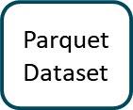
Core Services vs. DDMS

Slide 25
OSDU Platform Catalog – Group Types

Slide 26
OSDU group type
Master Data
Objects created by a company’s business processes
Single version of truth – Well Known Entity
Work Product Component
Output of a business object (master data)
Are measurements or observations from the object,
Reference Data
Often “type” concepts
Often defined outside of the company, e.g., by standards organizations
Object is versioned; identity is not
Describes a physical object, or business activity
Catalog of objects grows and changes slowly
Or derivatives and interpretations of these outputs
Are immutable and typically not versioned
There is no authoritative record, but preferred
Have associated artefacts
Maybe one of three governance levels:
FIXED - may not edit or add values
OPEN - may add, but not edit existing values
LOCAL - may add and/or edit any values
Section 2, OSDU Schema Usage Guide
Demystifying Well Known Schema/Entity
Notes:
Data type proposals must be assigned an OSDU group type, and the group type dictates the degree of specificity and comprehensiveness needed for the definition
These are the primary group types for data modelling activity

Slide 27
OSDU group type
Work Product
Dataset
A set of work product components for ingestion
May comprise multiple different entity types
The “shipping label”
Used for audit purposes
There is only one entity type
Metadata about the location of the data described by a work product component
Could be a binary file, or location in a physical data store
Current data set manifestations are File and File Collections
Specializations of each exist
Section 2, OSDU Schema Usage Guide
Notes:
Data type proposals must be assigned an OSDU group type, and the group type dictates the degree of specificity and comprehensiveness needed for the definition
Work product is unlikely to be affected by data modelling activity
Dataset may be expanded beyond current permutations, but more likely as a Horizon 2 or 3 activity

Slide 28
Am I aiming to define object OR List of Values Container
Lists
Reference-Data
Business Object
Am I bridging to any existing content storage (file, external source,….)
YES
Am I bridging to any existing content storage (file, external source,….)
Work-Product-Component
?? Content Storage ??
No Self Standing Entity
Am I defining a tangible, concrete object ?
YES
Am I defining a tangible, concrete object ?
Master-data
What kind of lifecycle the object I’m defining is having
Long Term – Pesistant
Short Term Snapshot
YES
Am i dealing with measurements, computations, interpretations ?
NO
What level of complexity the model seems to follow ?
Complex
Subject to Nesting
Simple
Stable over the time

Slide 29
Questions?

Slide 30
OSDU Data Concepts Roadmap (Optionally)

Slide 31
Data Definition Roadmap – 2023-2024
P1
P2
P3
Seismic Interp.
Microseismic
Improve “Activity” (Ref. Data)
Improve Real Time Data
Develop “Opportunity”
Lead & Prospect
Basin
Site Surveys (2D/3D – HR)
DTS & DAS
Bring “AFE/Costs”
Lithology & Logs
Fluid Synthesis
PVTs
Core Logs
SCAL
Improve Well Logs
Stratigraphy
Petrophysics Interp.
- Petrography/Petrology (Reservoir Quality, thin section, point count,…)
- - Rock Mechanics
- Well Log Time/Depth Model
- Digital Rock (CT file/dataset)
- Mineralogy (XRD/XFD)
General Geochemistry
Fluid Blending
Well Tests
Formation Pressure
Revive:
Event DownTime
Daily & Monthly Report
Production Measurements
Interval Properties
Simulation Deck
Interpreted Facies
Static & Dynamic Properties
Hierarchical Model
Slot
Production Facility & Pad
-Prod. Offset
-Well Test Offset
Well Design
Choke Side

Slide 32
Data Definition Roadmap – 2023-2024 – Cross Dependencies
P1
P2
P3
Seismic Interp.
Microseismic
Improve “Activity” (Ref. Data)
Improve Real Time Data
Develop “Opportunity”
Lead & Prospect
Basin
Site Surveys (2D/3D – HR)
DTS & DAS
Bring “AFE/Costs”
Lithology & Logs
Fluid Synthesis
PVTs
Core Logs
SCAL
Improve Well Logs
Stratigraphy
Petrophysics Interp.
- Petrography/Petrology (Reservoir Quality, thin section, point count,…)
- - Rock Mechanics
- Well Log Time/Depth Model
- Digital Rock (CT file/dataset)
- Mineralogy (XRD/XFD)
General Geochemistry
Fluid Blending
Well Tests
Formation Pressure
Revive:
Event DownTime
Daily & Monthly Report
Production Measurements
Interval Properties
Simulation Deck
Interpreted Facies
Static & Dynamic Properties
Hierarchical Model
Slot
Production Facility & Pad
-Prod. Offset
-Well Test Offset
Well Design
Choke Side

Slide 33
Data Definition Roadmap – 2023-2024 – Domains
P1
P2
P3
Generic & General Subsurfaces
Seismic Interp.
Microseismic
Improve “Activity” (Ref. Data)
Improve Real Time Data
Develop “Opportunity”
Lead & Prospect
Basin
Site Surveys (2D/3D – HR)
DTS & DAS
Bring “AFE/Costs”
Subsurface - Samples
Lithology & Logs
Fluid Synthesis
PVTs
Core Logs
SCAL
Improve Well Logs
Stratigraphy
Petrophysics Interp.
- Petrography/Petrology (Reservoir Quality, thin section, point count,…)
- - Rock Mechanics
- Well Log Time/Depth Model
- Digital Rock (CT file/dataset)
- Mineralogy (XRD/XFD)
General Geochemistry
Fluid Blending
ReservoirS & Production Facts
Well Tests
Formation Pressure
Revive:
Event DownTime
Daily & Monthly Report
Production Measurements
Interval Properties
Simulation Deck
Interpreted Facies
Static & Dynamic Properties
Facilities
Hierarchical Model
Slot
Production Facility & Pad
-Prod. Offset
-Well Test Offset
Well Design
Choke Side

Slide 34
Questions?

